Slide 1
GloVe: Global Vectors for Word Representation
Jeffrey Pennington, Richard Socher, Christopher D. Manning
Mykhailo Druhov,
Yernar Kubegenov,
Kilian Hümmer,
Alexander Prisak

Slide 2
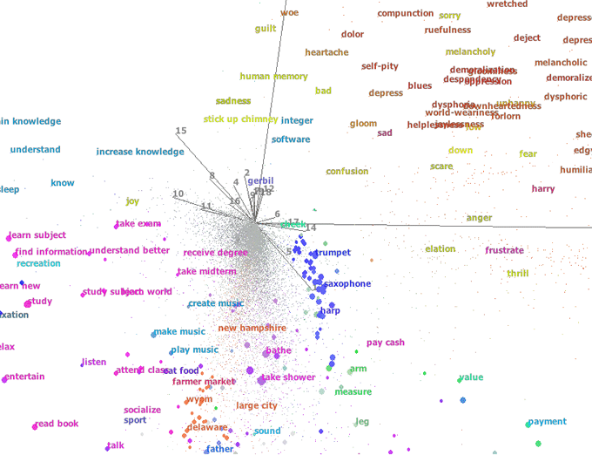
Semantic Vector Space Models
Are a type of machine learning models that represent the meaning of words or phrases as high-dimensional vectors in a mathematical space.
They are used for:
information retrieval (Manning et al., 2008)
document classification (Sebastiani, 2002)
question answering (Tellex et al., 2003)
named entity recognition (Turian et al., 2010)
parsing (Socher et al., 2013)
https://www.researchgate.net/publication/262291998_A_graph-based_approach_to_commonsense_concept_extraction_and_semantic_similarity_detection

Slide 3
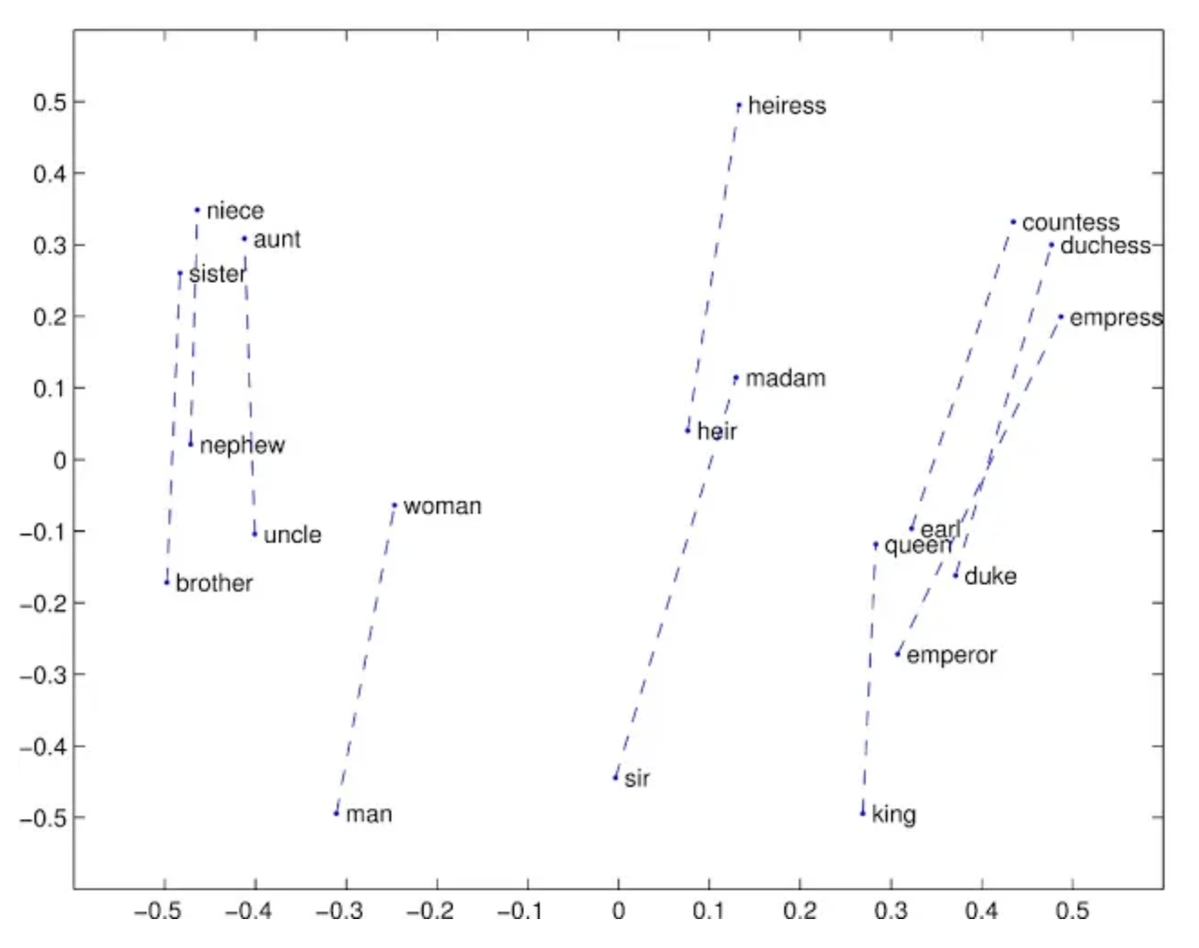
How to evaluate the “quality” of these vectors?
Calculate the distance or angle between word pairs
Examine various dimensions of difference between vectors (Mikolov et al. 2013)
Example for the 2nd method:
“king is to queen as man is to woman”
-> king − queen = man − woman

Slide 4
How to learn the word vectors?
There are two main approaches:
global matrix factorization methods (example: latent semantic analysis LSA) (Deer- wester et al., 1990)
Advantage: efficiently leverage statistical information
Disadvantage: the method does poorly on the word analogy task
local context window methods (example: the skip-gram model of Mikolov et al. (2013))
Advantage: skip-gram does better on the word analogy task
Disadvantage: poorly utilize the statistics of the corpus, because they train on a local context window

Slide 5
What can be done better?
Use a global log-bilinear regression model
The model is trained global word-word co-occurrence counts, thus, making efficient use of statistics
→ GloVe

Slide 6
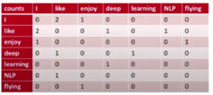


Glove Idea
Co-occurrence Matrix
Co-occurrence probabilities
Minimize Cost Function

Slide 7

Co-occurrence Matrix
•Example corpus:
•I like deep learning
•I like NLP
•I enjoy flying

Slide 8
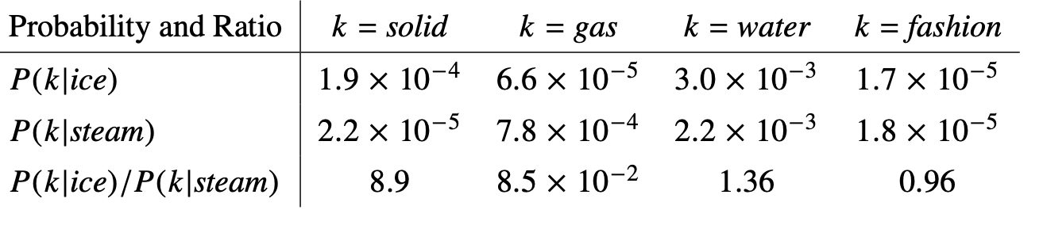
Co-Occurrence Probabilities
The spotlight of GloVe model is on ratios of co-occurrence probabilities.
the ratio is able to distinguish relevant words (solid and gas) from irrelevant words (water and fashion) more efficiently
Co-occurrence probabilities for target words ice and steam with selected context words

Slide 9
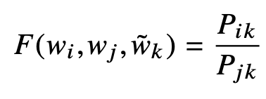
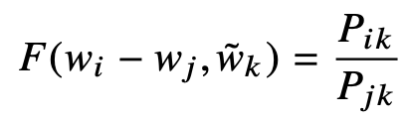
Model
The appropriate starting point for word vector learning should be with ratios of co-occurrence probabilities rather than the probabilities themselves.
the left-hand side presents arbitrary function that takes three parameters.
the right-hand side of the equation is extracted from the corpus.
by encoding the information present in Pik/Pjk in the word vector space an updated equation is computed:

Slide 10
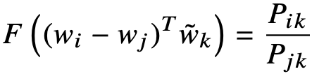
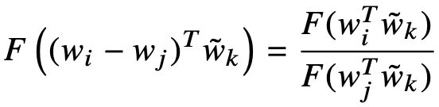

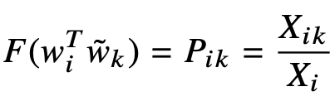

Model
the current model has a couple of drawbacks:
left-hand side contains vectors while right-hand one is represented by a scalar value. This problem is solved by applying of dot-product to the arguments.
final model should be invariant under this relabeling of vectors -> homomorphism assumption between the groups (R,+) and (R>0, ×). As the result, F = exp(x)

Slide 11

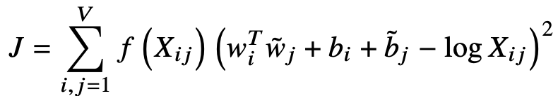
Model
The term Xi is independent of k so it can be absorbed into a bias bi for wi . Finally, adding an additional bias bk for wk restores the symmetry
Main drawback of this model - all the co-occurrences are weighed equally (even the rare ones)
Solution - casting the upper equation as a least squares problem and introducing a weighing function f (Xi j ):

Slide 12
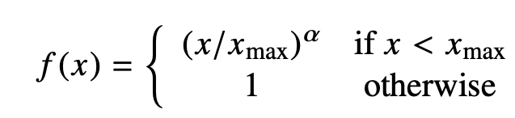
Model
Weighing model f should fulfill the following requirements:
f(0) = 0
f is non-decreasing
f should be relatively small by large x

Slide 13
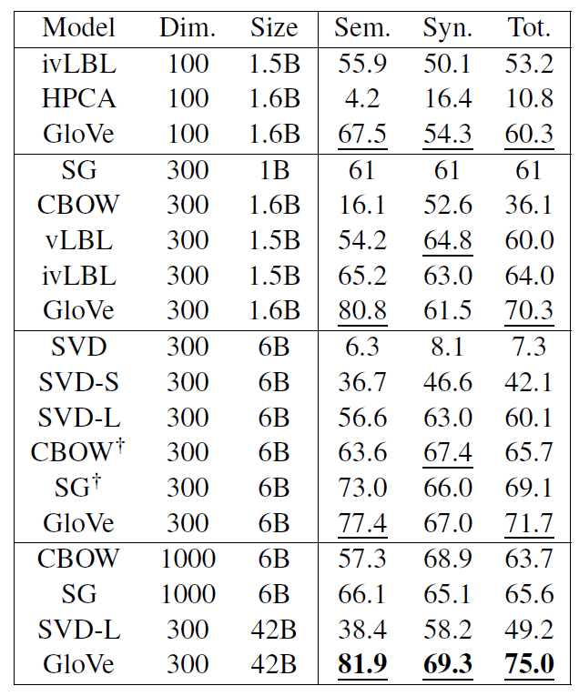
Experiments #1: Analogy task
Analogy task
Semantic subset: "a is to b as c is to ?"
Syntactic subset “fly is flying, dance to what?”
Result:
GloVe model performs significantly better than the other baselines.
highly efficient and effective in capturing the semantic relationships between words.
Table 2: Results on the word analogy task, given as percent accuracy. Underlined scores are best within groups of similarly-sized models; bold scores are best overall.

Slide 14
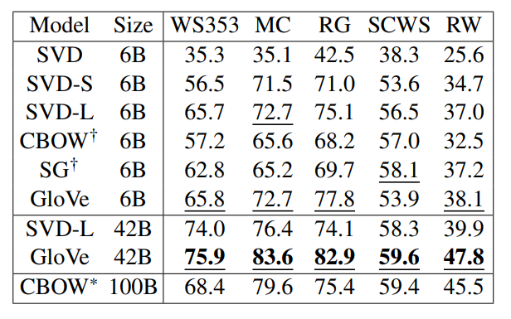
Experiment #2: Word Similarity
Task:
It shows the vector space substructure
Result:
Outperformed all previous baseline models
Table 3: Spearman rank correlation on word similarity tasks. All vectors are 300-dimensional. The CBOW∗ vectors are from the word2vec website and differ in that they contain phrase vectors.

Slide 15
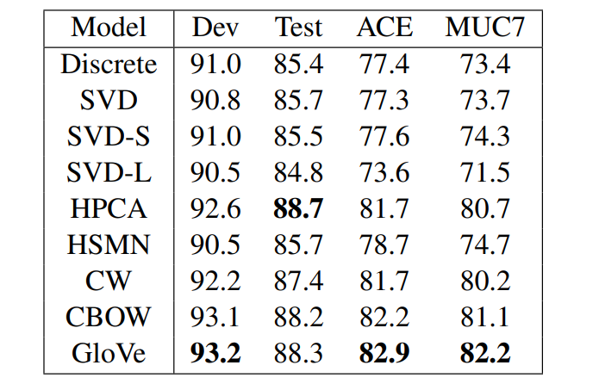
Experiment #3: Named entity recognition(NER)
Task:
Was about to recognise the main 4 types of entity: person, location, organization, and others
They trained model on CoNLL-03 training dataset
Result:
The GloVe model outperforms all other methods on all evaluation metrics, except for the CoNLL test set, where the HPCA method performs slightly better.
Table 3: Spearman rank correlation on word similarity
tasks. All vectors are 300-dimensional. The
CBOW vectors are from the word2vec website
and differ in that they contain phrase vectors.

Slide 16
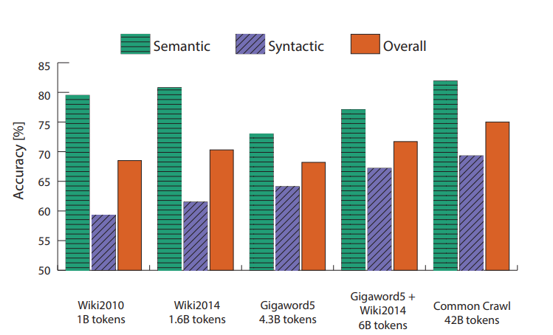
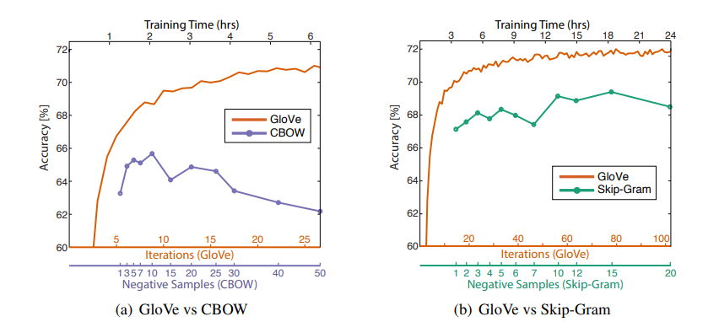
Parameter Analysis

Slide 17



Links to sources:
GitHub GloVe Repo
Paper
Article about GloVe

